Slide 1
Indonesia Android Kejar
Beginner Class

Slide 2
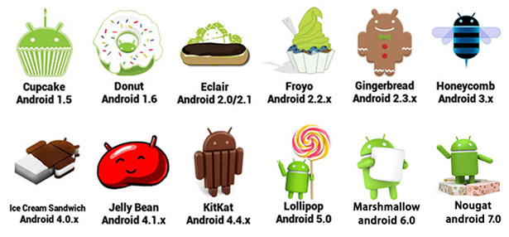
Perkembangan Android

Slide 3
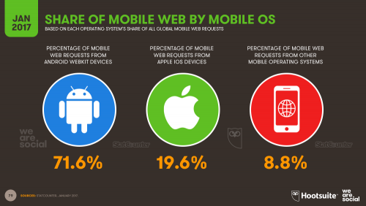
Angka Pertumbuhan

Slide 4

Android di Indonesia

Slide 5
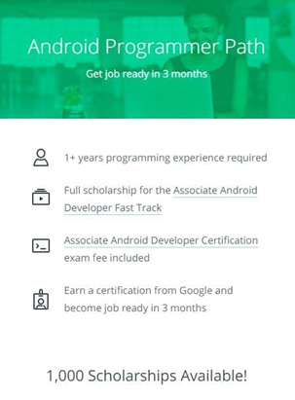
Google Developer
Google Scholarship

Slide 6

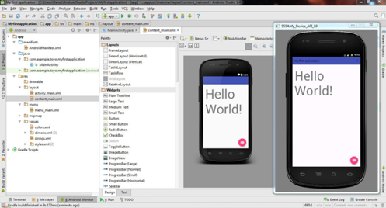
Build Tools
Android Studio
Emulator
HP Android

Slide 7
R E A D Y ?

Slide 8
Nama Kerja/ sekolah/ kuliah Skill pemrograman Kenapa ikut kelas ini ?

Slide 9
Day 1
Git
Linear Layout
Relative Layout
Login Form
Intent

Slide 10
Day 2
List View
Recycler View
Detail Form
Final Project

Slide 11
Bonus Stage
Shared Preferences
Option Menu
API

Slide 12
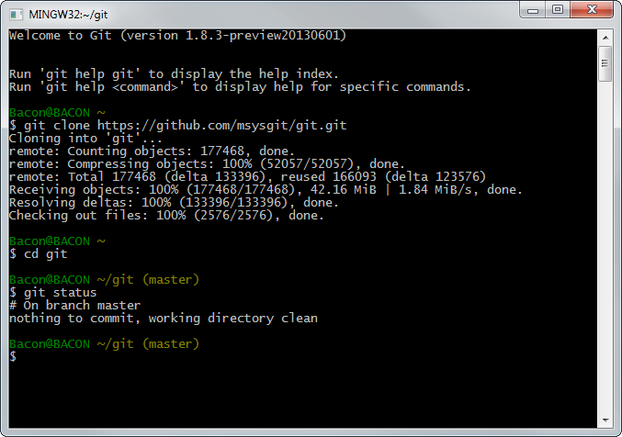

Day 1
Git

Slide 13
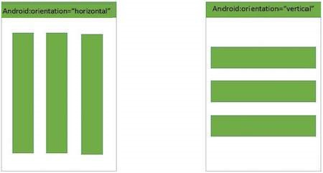
Day 1
Linear Layout

Slide 14
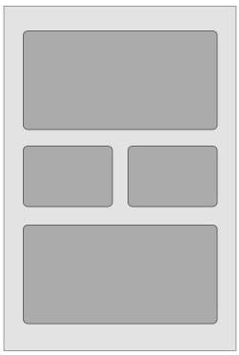

Day 1
Relative Layout

Slide 15
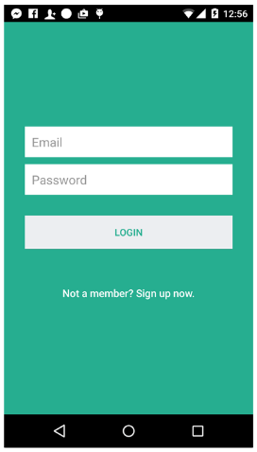
Day 1
Login Form

Slide 16
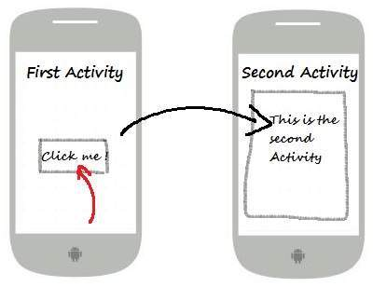
Day 1
Intent

Slide 17


Day 2
ListView dan RecyclerView

Slide 18
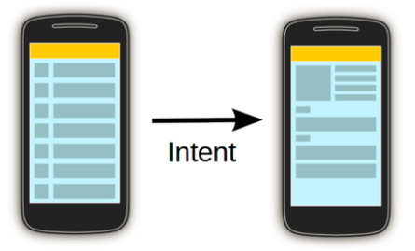
Day 2
Detail Form

Slide 19
Final Project

